Slide 1


ATTENDANCE MANAGEMENT USING QR CODE
COLLEGE OF ENGINEERING ROORKEE
PRESENTED BY
-SNEHA GUPTA
-TANISHA SINHA
-AVISH TYAGI
-UDAY PUNIA

Slide 2
INTODUCTION
Nowadays, taking attendance mutually by using paper and pen was one approach we used even we knew the process seems slow and unproductive.
Students play truant and trying to cheat on their attendance by asking friends to put initial on the attendance sheet.
This project proposed as an alternative solution for educators to streamline the process of taking the attendance by using QR code.
This system is a web based system under the supervision of lectures to generate the QR code and to collect data of the attendance.

Slide 3
PROBLEM STATEMENT
Record of students attendance are done manually by using attendance sheet during class session.
The attendance sheet could be lost and it gives opportunity for students to cheat their attendance .
Students play truant and parents did not notify their children’s attendance for classes.

Slide 4
OBJECTIVE
To design an efficient computerized attendance system to be used for lectures , students and parents.
To implement the system to facilitate the lectures managing student’s attendance.
To evaluate the effectiveness of the system in order to notify parents regarding the student’s attendance.

Slide 5
SCOPEs-
ADMIN
- Has privileges to control all lecturer , student and parent management.
LECTURER
- Lecturer may login the system which username and password provided by admin.
- Lecturer can edit , update and take attendance of the class.
- Lecturer can view the attendance list of the students and generate the report.
STUDENT
- Student needs to login the system which username and password provided by admin.
- Student can update the profile or register their parent information.
PARENT
- Parent can login to the system which username and password provided by admin.
- Parents may receive weekly attendance report via sms notification and online system.

Slide 6

LIMITATIONs-
There are no devices provided for this system.
Difficulties will occur for the system to notify weekly report if the parents stays abroad and not set the number for international caller.

Slide 7
EXPECTED RESULTs-
The system able to manage student attendance record efficiently.
The system able to facilitate lecturers to collect data and information .
The system notify the attendance record for parents effectively.

Slide 8


PROCESS MODEL

Slide 9
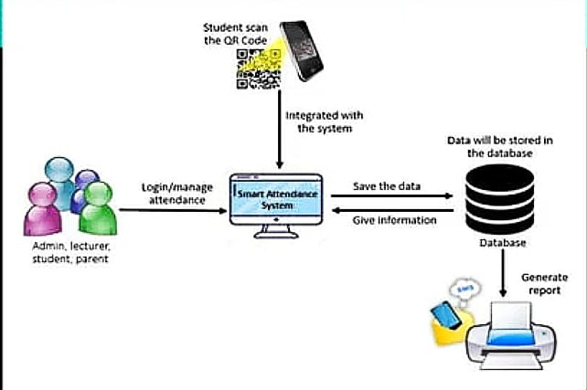
FRAMEWORK

Slide 10
SOLUTION COMPLEXITY

Slide 11
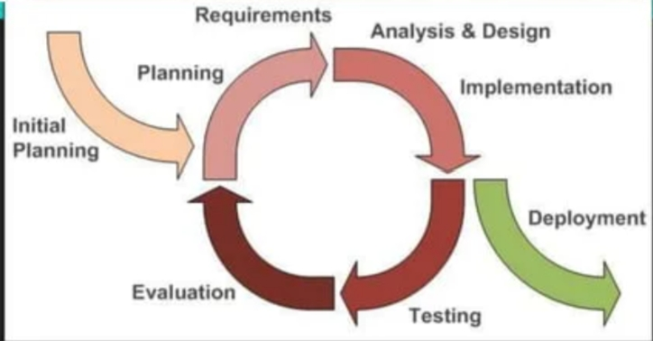
ITERATIVE MODEL

Slide 12
PHASES
INITIAL PLANNING-
In this phase, the brainstorming session started and the title for the personal project. The problem of system was identified before proceed to next phase.
PLANNING PHASE-
The specific goals were identified in this phase. This planning process includes the detailed overview of each goal, including the reason for its selection and the outcome of goal system.
ANALYSIS PHASE-
All requirement was analysed and the problem fully understood. The information from related journal, papers and existing system was gathered to have a better understanding in developing the system.

Slide 13
DESIGN PHASE-
In this phase, context diagram , ER diagrams , data flow diagrams , and database was designed to know more details about the system.
IMPLEMENTATION PHASE-
In this phase, it takes the prototype from the design phase and converts in working model, the decisions from the previous phase will influence how the implementation phase will be actually carried out.
TESTING PHASE-
In this phase, the system is tested and bugs is corrected to determine whether the system meets the specific requirement and find any errors or not.
DEPLOYMENT PHASE-
The system is ready to be used by user . Once the system is stable, it is reviewed that the system meets all the goals in the project plan for the satisfaction.
EVOLUTION PHASE-
In evolution phase, the effectiveness of program operations, implementation and service delivery were analysed. It helps to determine the effectiveness of program.

Slide 14
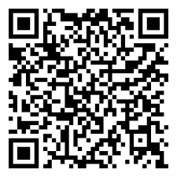
METHOD/TECHNIQUE QR CODE
Quick response code, is a two dimensional code used to record
thousands of characters and numbers in a small image created.
Modules(fundamental unit of QR code)store data and make up
the rows and columns of the QR code(data matrix)

Slide 15
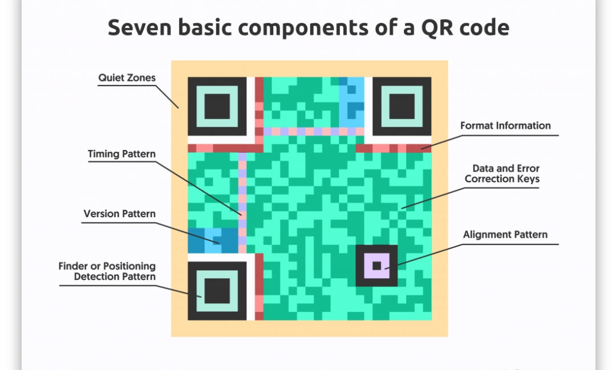

Slide 16
POSITION PATTERNS:
Help scanners to find the edges of
QR code.
VERSION INFORMATION:
It is directly connected with their dimensions
and the amount of data which should be encoded.
TIMING PATTERNS:
Enable the scanning software to understand the width of a single module.
FORMAT INFORMATION:
Helps the scanning device to define the data format , enclosed in the QR code.

Slide 17
ALLIGNMENT PATTERNS:
Allows the scanning device to define the possible perspective distortion of the QR code image.
DATA AND ERROR CORRECTION KEYS:
It has a capability to remain scannable even if it damaged.

Slide 18
Qr code working interface

Slide 19
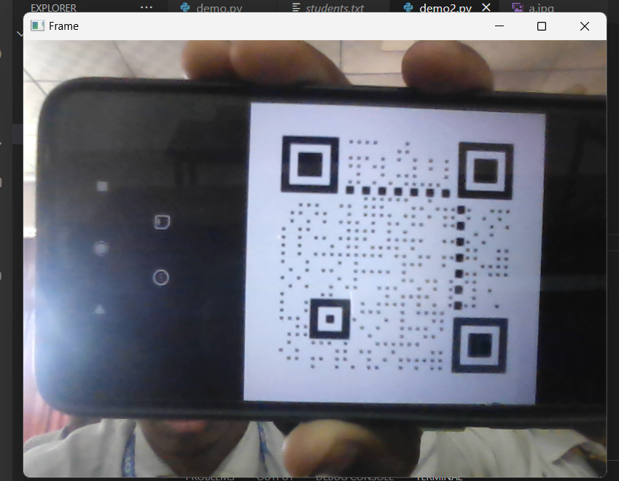

INPUT
OUTPUT

Slide 20
THANK YOU!!😊

